Slide 1
Telecom Churn Analytics

Slide 2
Objective:
  Model will find out the commendation or complaint of customer with knowing their type, year, area for Development of a good services and monitoring churn of customers.
Benefits:
  Detection of complaints area.
  Gives better insight of customers problems.
  Helps in easy flow for managing resources.
  Helps in understand churning reasons.

Slide 3
Data Sharing Agreement :
  Sample file name (ex. mta-customer-feedback-data-beginning-2014-1.csv)
  Length of date stamp(4 digits)
  Length of Quarter stamp(1 digits)
  Agency
  Commendation and complaint
  Subject Matter / detail
  Issue Detail
  Branch/ line/ route

Slide 4
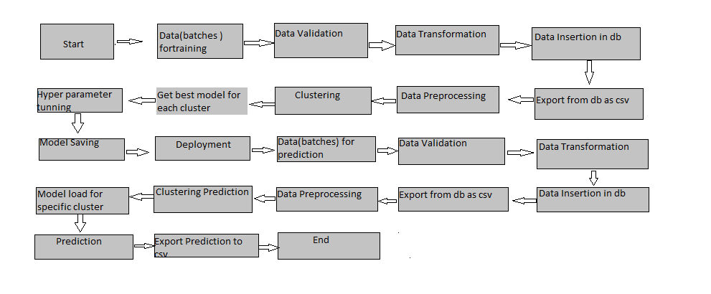
                Architecture

Slide 5
Prediction:
  We can filter out the Customers connection with their area and branch line with their comment of commendation or complaint. With the help of this we can predict Customers satisfaction and churn.
  Also we can easily solve Customers issue by knowing their accurate details.

